Slide 1
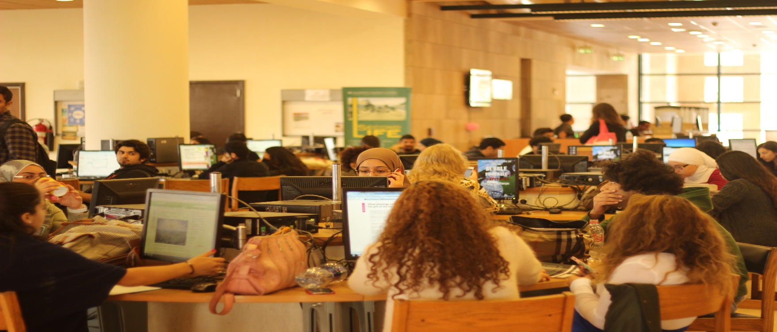
LEARNING COMMONS AT AUC Pandeli Glavanis Riham Massoud
PANDELI GLAVANIS
RIHAM MASSOUD

Slide 2
MISSION STATEMENT
As the public face of six units, the Learning Commons exists to bring together the content, technology and services offered by the different units in one physical location to support learning.
The goal is to provide a seamless work environment giving users the tools and support to access, manage, and produce information, from idea formation to knowledge production, at a single workstation

Slide 3
THE UNITS
The Library
Reference Librarians
Writing Center
Multimedia Center
Information Technology
Student Technology Assistants

Slide 4
MAJOR CHARACTERISTICS
Technology
Users are able to access a broad range of hardware and software tools in the Learning Commons allowing them to access the rich content of the library as well as manage and produce research output and multimedia projects from one location.

Slide 5
Collaborative / Group Learning
While individual study will be supported in other areas of the library, the emphasis in the Learning Commons will be on collaborative learning with flexible spaces focused on supporting small to medium sized groups. This comfortable, relaxed environment also allows the blending of social interaction and work, as demanded by the modern student.

Slide 6
Service
Learning Commons’ users will be provided with easy and convenient access to the full range of services and support required by modern scholarly activity.
Instructional technologists, IT specialists, Student Technology Assistants and other campus service providers such as the Writing Center staff, will work alongside reference librarians to provide targeted support to users as and when required.

Slide 7
MANAGEMENT
Head of Research and Information Services (co-chair)
Associate Director of CLT (co-chair)
Associate Director, Academic Computing Operations of ACS (co-chair)
Head of Library Automated Systems
Reference Manager
STA Coordinator
Technical Support Coordinator

