Slide 1
Graph thinking, linked open data & semantic web: preparing for the post-MARC world.
ANCHALEE PANIGABUTRA-ROBERTS (Joy)
HEAD OF CATALOGING & METADATA
AMERICAN UNIVERSITY IN CAIRO LIBRARIES
AMICAL CONFERENCE 2015 ~ AMERICAN UNIVERSITY IN BULGARIA
Notes:
Today’s presentation is to give a basis for our discussion and hopefully for establishing a working group on BIBFRAME and Linked Data for our consortium.
I want to ensure that we have a common understanding on linked data and Semantic Web and what the post-MARC world will look like, going forward.
This presentation is, in part, based on my conference report for Semantic Web in Libraries Conference I attended in Bonn, Germany, in December 2014. I will focus on BIBFRAME, but in the context of Linked Open Data’s development in the GLAM (Galleries, Libraries, Archives and Museums) communities.
I will try to make sure we have time for our discussion later on.

Slide 2
What’s The riddle of the day?
Digitized/Digital/
Electronic Resources
Discovery Tools/Services
The Visible Library
“Semantic Web”
Notes:
Image credits: Discovery tools: a bibliography: https://discoverytoolsbibliography.wordpress.com/
From Naseej: http://naseej.com/Sliders/03-Digitization-02.aspx?width=521&height=201&ext=.jpg

Slide 3
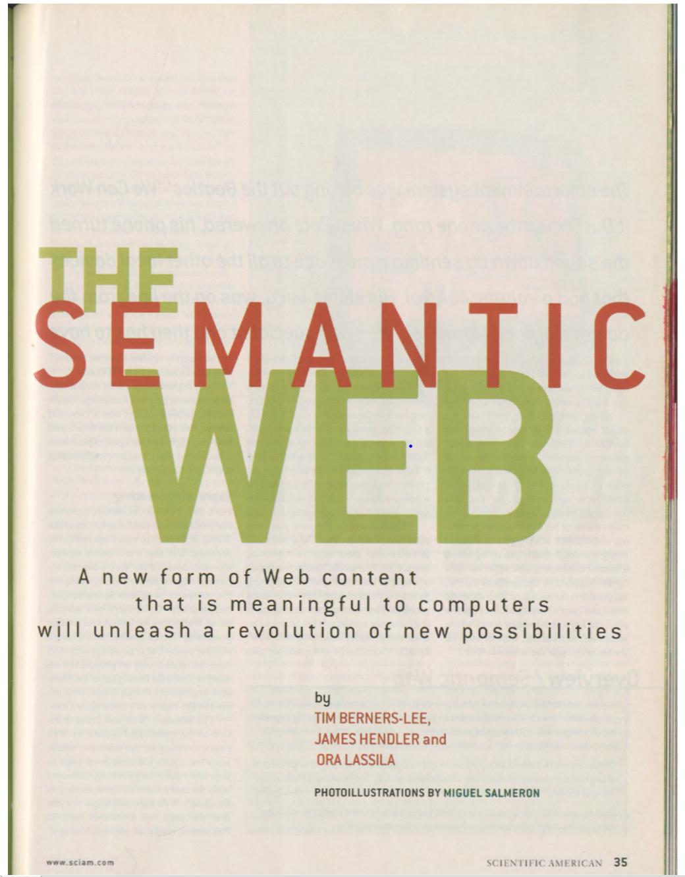
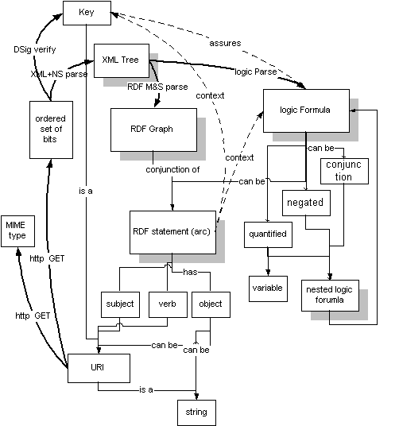
Berners-Lee’s Semantic Web (1998)
Notes:
So I am bringing the new riddle from the sphinx to you; the riddle of the Semantic Web and how it will “unleash a revolution of new possibilities”, as stated by Berners-Lee, Hendler and Lassila, in their 2001 article, published in Scientific American.
Images:
Berners-Lee, Tim. 1998. Semantic Web’ Road Map: http://www.w3.org/DesignIssues/Semantic.html
Berners-Lee, T., J. Hendler, and O. Lassila. 2001. "The Semantic Web". SCIENTIFIC AMERICAN -AMERICAN EDITION-. 284: 28-37.

Slide 4
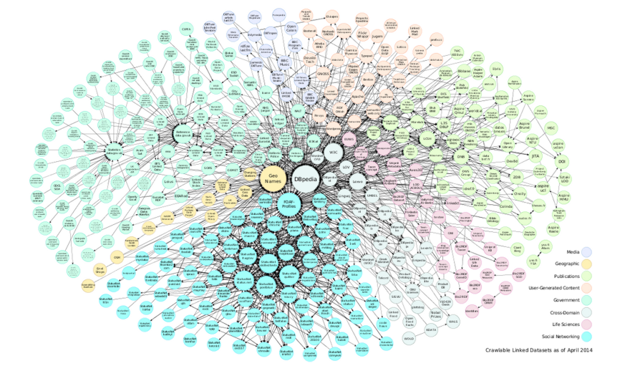
The visible library
Semantic Web, Linked Open Data
& BIBFRAME -> Schema.org
Notes:
Because, currently MARC data is not designed for the Web.
Image: Miller’s slide –”We aren’t yet speaking in a way the Web understands” (with our current data). The libraries are not present in the middle of the Linked Data Cloud here.
BF and LOD projects try to change that.
To have our library data to ‘speak the language of the Web’, we need to transform our library data to be web-based data to be ‘visible’ on the Web.
The goal involves the assessment and planning for the implementation of BIBFRAME and also with Schema.org.
If BF & Schema.org implementation are successful, we will be constructing the world’s ‘brain’ or knowledge network in an unprecedented manner.
Image: Linked Open Data cloud diagram 2014, by Max Schmachtenberg, Christian Bizer, Anja Jentzsch and Richard Cyganiak. http://lod-cloud.net/

Slide 5
Semantic web
“The semantic web marks a move from a global web of human readable documents (web pages), to a global web of machine readable documents; so that machines can automatically interpret the meaning of data on the web; what to do with it, and how to represent it.”
– What is the semantic web? http://www.linkeddatatools.com/index.php
Notes:
To really understand BIBFRAME, we need to also understand what Semantic Web and Linked Open Data are, since they underpin the development of BIBFRAME.

Slide 6
Semantic Web & Linked Data
Web pages - HTML documents that are linked to each other through the use of hyperlinks.
Humans or machines can read these documents.
Machines (computers) can read only by seeking keywords in a page.
Semantic web or web 3.0 technology ~ a shift from publishing data in human readable HTML documents to machine readable documents.
Similar to what MARC has done for the databases (with numbers for coding data), but with language-based labels.
MARC data’s limitation; number-based codes, hidden in local databases and manipulated by local systems only, not sharable on the web.
Linked data ~ library data can now be published as web-based data that can be easily sharable, findable and linkable on the web.
Source: Semantic web basics: http://www.linkeddatatools.com/semantic-web-basics
Notes:
web pages - HTML documents that are linked to each other through the use of hyperlinks. Humans or machines can read these documents, but the computers
can only search and take actions on keywords in each webpage.
Computers/machines have difficulty extracting any meaning from these documents themselves.
Semantic Web or Web 3.0 technology shifts from publishing data in human readable HTML documents to machine readable documents, allowing for data exchange on the Web.
It is similar to what MARC has done for the databases, but the MARC data are formatted for databases, not for the Web to understand.
Linked data changed that. Going forward into the future, library data can be published as web-based data that can be easily sharable and linkable on the Web.

Slide 7
Linked Data (Graph) Model
Bengie is a dog. Bonnie is a cat. Bengie and Bonnie are friends.
Data
Description
Relationship
http://www.linkeddatatools.com/introducing-rdf
Notes:
This graph represents the way computers can understand/see the data, based on the Object-Relationship Model.
As for the relationships used for linking data, this is a new feature that we did not use explicitly in AACRs, but now added to RDA, Appendixes I, J, K and L. For example, we can establish the links among works and their creators – author, composer, cartographer, or among works, such as, adaptation of, translation of, and so forth.
I hope that this linked data model makes sense to you and helps you understand how the RDF model works, based on the linked data concept.
We want to focus on what Richard Wallis at OCLC called ‘things’ not ‘strings’ as we have seen in MARC-based library data.

Slide 8
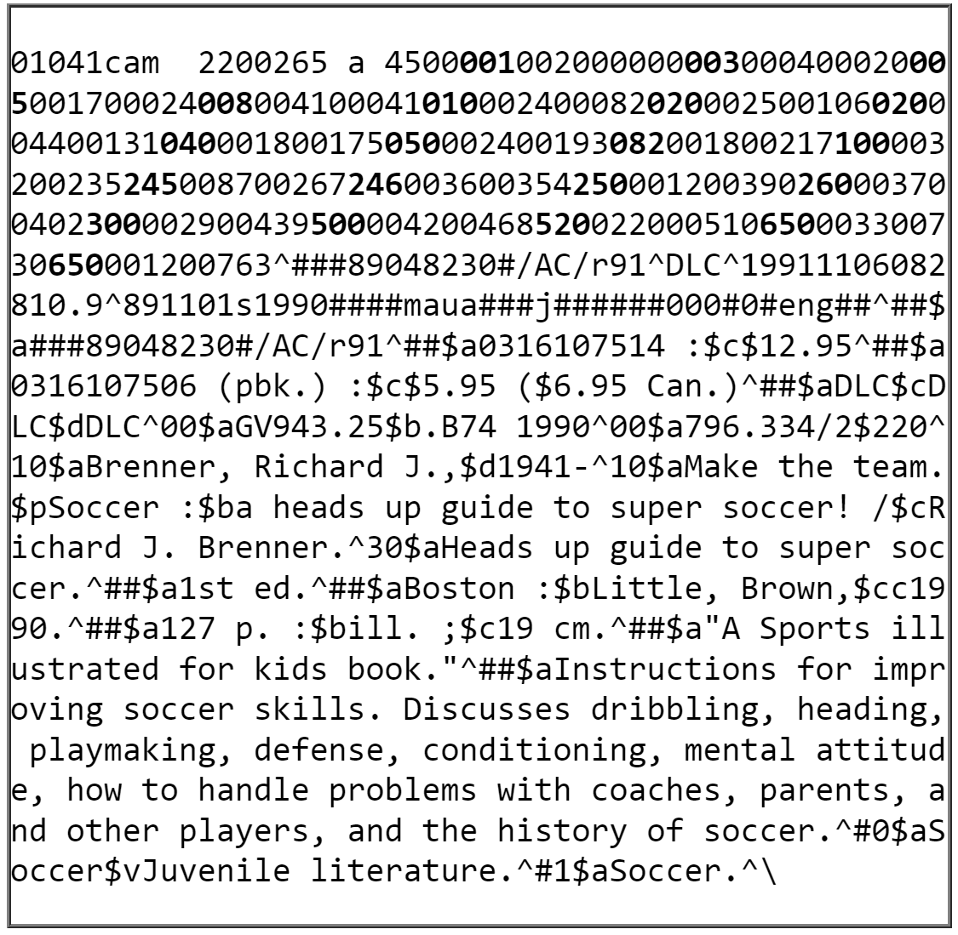
‘Things’ not ‘strings’
Source: LC’s Understanding MARC Bibliographic, part XI: http://www.loc.gov/marc/umb/um11to12.html

Slide 9
Bringing back ‘RDF’ to the future…
EXAMPLE 1: Sample triples (informal)
<Bob> <is a> <person>.
<Bob> <is a friend of> <Alice>.
<Bob> <is born on> <the 4th of July 1990>.
<Bob> <is interested in> <the Mona Lisa>.
<the Mona Lisa> <was created by> <Leonardo da Vinci>.
<the video 'La Joconde à Washington'> <is about> <the Mona Lisa>
RDF Primer: http://www.w3.org/TR/2014/NOTE-rdf11-primer-20140225/#fig1
See also an example of RDF data in comparison to the relational database info.:
http://forge.taotesting.com/projects/tao/wiki/RDF_by_example
Notes:
RDF (1998): http://www.ariadne.ac.uk/issue14/what-is
So how does linked data work in the GLAM (galleries, libraries, museums, and archives) settings?
From this Linked Data example, the data is labeled as ‘Bob’, but we also need to tell the computer that he is a person, not an animal. We can also add his birthdate which is July 14 1990. He also has a friend name Alice. Bob is interested in the Mona Lisa, the painting by Da Vinci, but Mona Lisa is also a subject of the video ‘La Joconde a Washington’.
And the data can be written for the Web for the computers to read in triples (see the sidebar).
So you can not only describe what your data are, but also what their relationships are in triples. Thus this data architecture gives you more powerful search results, since it is not based on the random keywords, but on the solid relationships and relevancy.
This type of linked data is based on RDF or Resource Description Framework, a way to describe data on the Web, so that the Web/computers can understand, based on the triples of subject, predicate and object, as in the sample ‘triples’ on the sidebar.
And you can keep adding more pieces of data and their relationships and attributes to the network.
Before you know it, you will be running parts of the world’s brain extended back into the human history and cover the knowledge from around the world and even from other planets with the data we collected through the ‘Curiosity Rover’ robot on Mars and satellites, space stations and the ocean data via NOAA (U.S.), or the ice data from the ANDRILL Project that go back millions of years.
It’s not just about putting MARC format away, as one may think.
And we can get to this goal collectively when libraries around the world surface their data to the Web and put ourselves in this Linked Data Cloud.
And this is a great potential for linking an extensive network of information for our users.
If you would like to learn more about RDF and see the comparison to relational databases, I recommend this article online, plus the RDF Primer where I got this example.

Slide 10
BIBFRAME as linked data
Notes:
BIBFRAME, the Bibliographic Framework initiatives by the Library of Congress and other national libraries as a replacement for MARC, since 2011, is also based on the RDF/linked data model.

Slide 11
BIBFRAME as LIBRARY LINKED DATA
http://www.loc.gov/bibframe/docs/model.html
Notes:
This is the very basic model of BIBFRAME or the lite model, based on FRBR – Functional Requirements for Bibliographic Records - model developed in 1998.
This is the FRBR ‘lite’ version, as well, with the basic elements of work and instance (a combination of FRBR’s expression and manifestation).
Think also about ‘Dublin Core’ with the basic 15 metadata elements. The creator of BIBFRAME, Dr. Eric Miller, brought together all of his works from RDF, Dublin Core, Semantic Web concepts to combine with FRBR. As a result, he gave birth to the BIBFRAME Model.

Slide 12
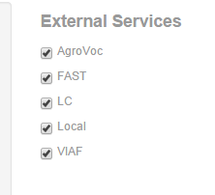
Bibframe editors
LC BIBFRAME: http://bibframe.org/tools/editor/
Zepheira’s BIBFRAME SCRIBE:
http://editor.bibframe.zepheira.com/static/
Notes:
You can test drive BIBFRAME by using these editors; the left-hand one was developed by the Library of Congress and to be tested by LC during April-June this year.
Next year LC and other libraries will test the production using BIBFRAME:
Philip Schreur’s (Interim Assistant University Librarian for Technical and Access Services at Stanford University) e-mail to BIBFRAME Listserv (2015-04-06):
“… working on organizing a project for 2016 called (initially) Linked Data for Production. It would be a group of six libraries (Stanford, Cornell, Harvard, Columbia, Princeton, LC) identifying the issues of transitioning their technical services environments to linked data, in this case making use of BIBFRAME, through actual production work.”
On the right-hand side of the screen is Zepheira’s BF editor used by their trainees and BIBFLOW’s testing at the University of California-Davis Libraries. You can also see here the linked data in action, with linking to the external services; LC authorities, Virtual International Authorities File, FAST headings at OCLC and AgroVoc (an online thesaurus).

Slide 13
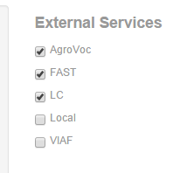
BIBFRAME scribe linking to agrovoc:
Notes:
For example, if you want to add the subject ‘rice’ to your data here, you can type in the word and it will send the query to the external services or the web-based, linked data sources. In this case, I chose AGROVOC, FAST and LC (authorities) for the external services.
The list below the data box here are the results of the search ‘rice’ sent to the selected sources. I found that there are different types of rice, so I chose the specific rice on the list from Agrovoc, Basmati rice, as a subject for this item: http://aims.fao.org/skosmos/agrovoc/en/page/c_330606
Agrovoc is a linked data project and a multilingual agricultural thesaurus, created by Food and Agriculture Organization of the UN (FAO).
This case demonstrates that you can choose different thesauri based on your needs, not limited to one thesaurus and derive the term(s) as linked data (URIs) from other linked data sources on the Web. Thus using BIBFRAME as linked data connects your library data to other web-based data and expand the options of metadata/vocabularies you can choose from.

Slide 14
An Arabic sample record converted from MARCxml to bibframe.
Zepheira’s BIBFRAME SCRIBE.
Notes:
This is an example of a MARCXML record converted to BF using Zepheira’s BF Scribe from a few Arabic records from AUC Libraries.
Examples of BF converted files: https://linksmith.zepheira.com/training/EaZQz584xe9wQEGJ3R5UeW/view
https://linksmith.zepheira.com/training/test-for-wsalesky/view

Slide 15
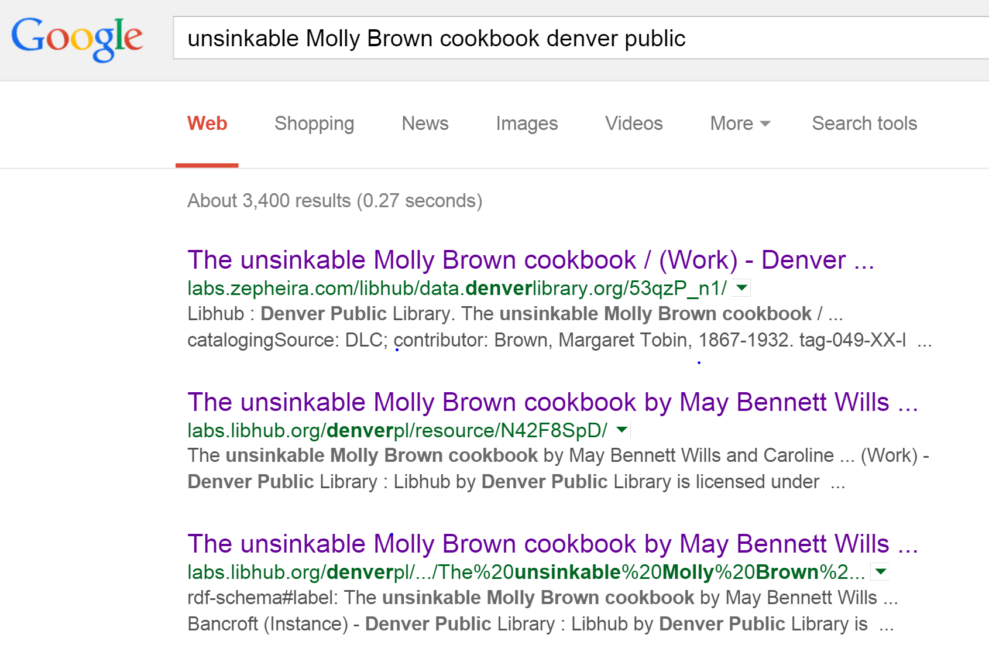
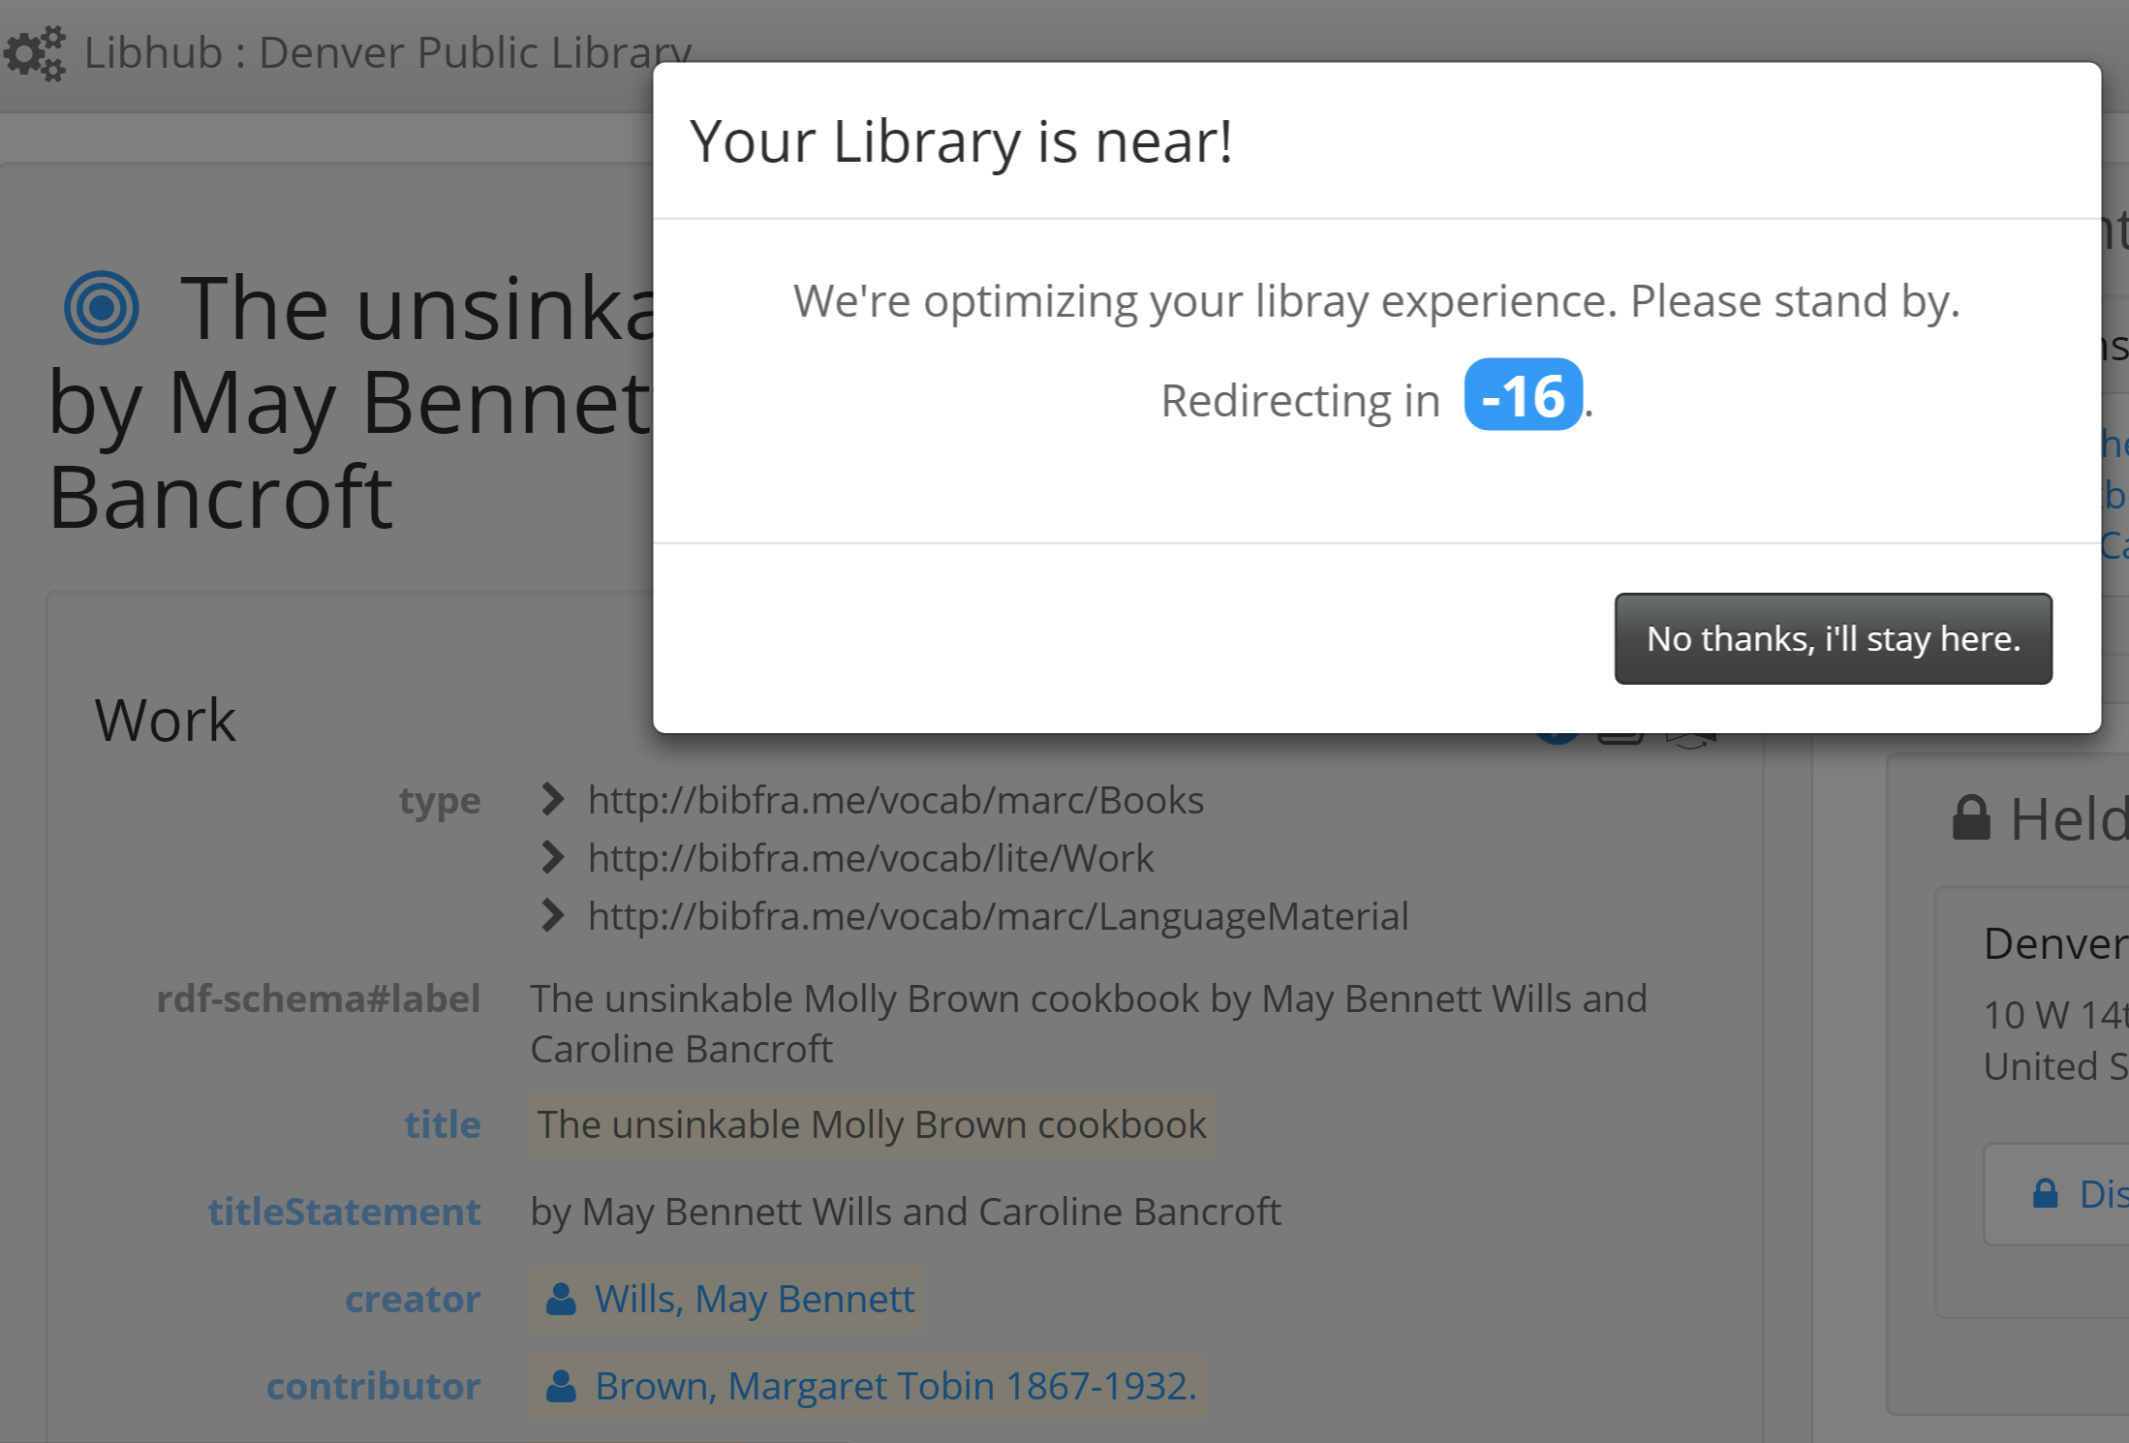
Zepheira’s Project with Denver Public Library:
http://goo.gl/nzR3UV

Slide 16
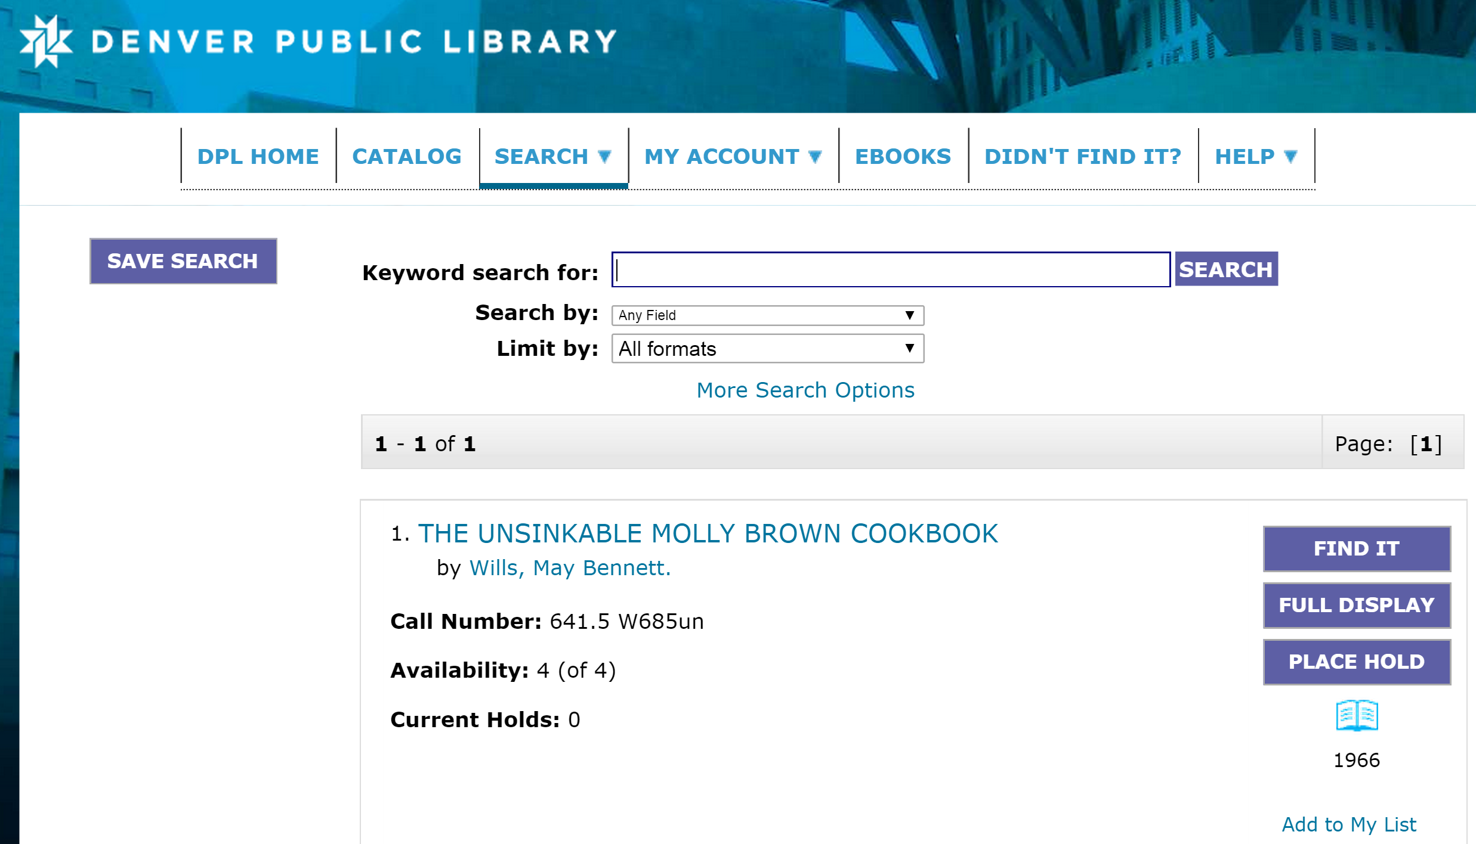

Slide 17
BIBFRAMe Example from DPL.
*To see how BIBFRAME & Schema.org
can be combined, use this link:
http://labs.libhub.org/denverpl/resource/N42F8SpD/
to view the codes via: http://linter.structured-data.org/

Slide 18
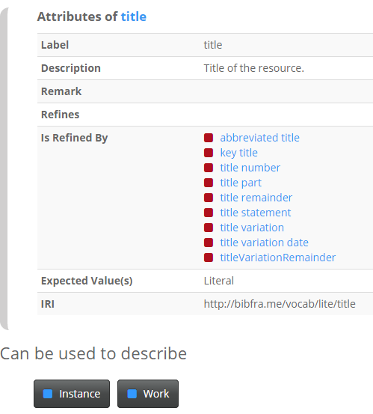
Bibfra.me
Notes:
BF’s new vocabulary navigator. You can see that BF allows different levels of details, from the ‘lite’ version to the profiles that fit different communities, from the library, rare materials to the archive metadata profiles.
Thus BF is ‘extensible’, which means you can modify the original BF to add more metadata elements based on your needs.
But by having the common core metadata elements, it allows the interconnection/interoperability among these different communities.
In this context, BF helps us break down the metadata silos we have in our current practices.
In essence, we will move away from numeric metadata coding (as in MARC), to language labels for metadata to be compatible with the modern metadata, such as, Dublin Core, VRA Core and other metadata standards.

Slide 19
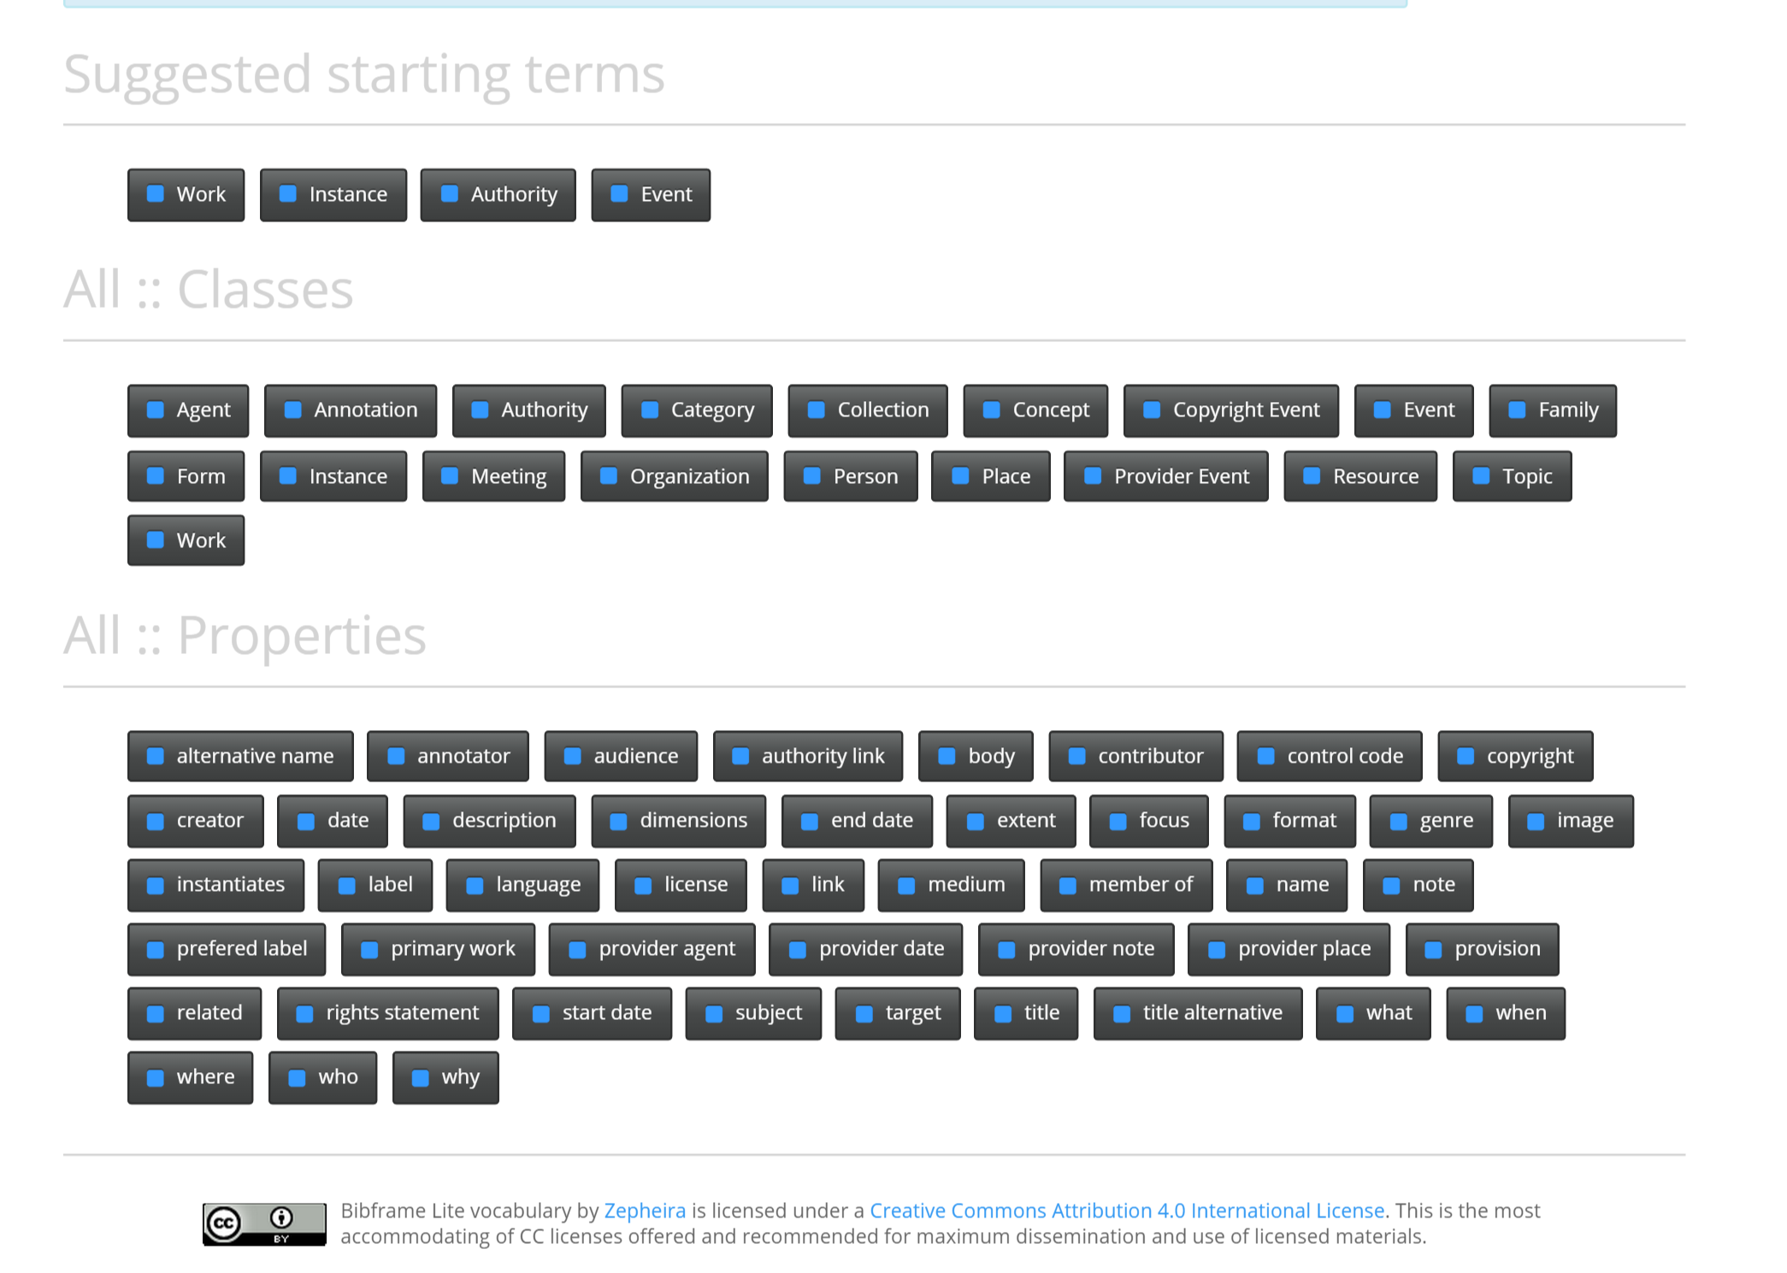
BIBFRA.ME LITE:
Core Metadata Elements:
http://bibfra.me/view/lite/
BIBFRA.ME Lite’s Vocabulary.

Slide 20
Other linked data examples.

Slide 21
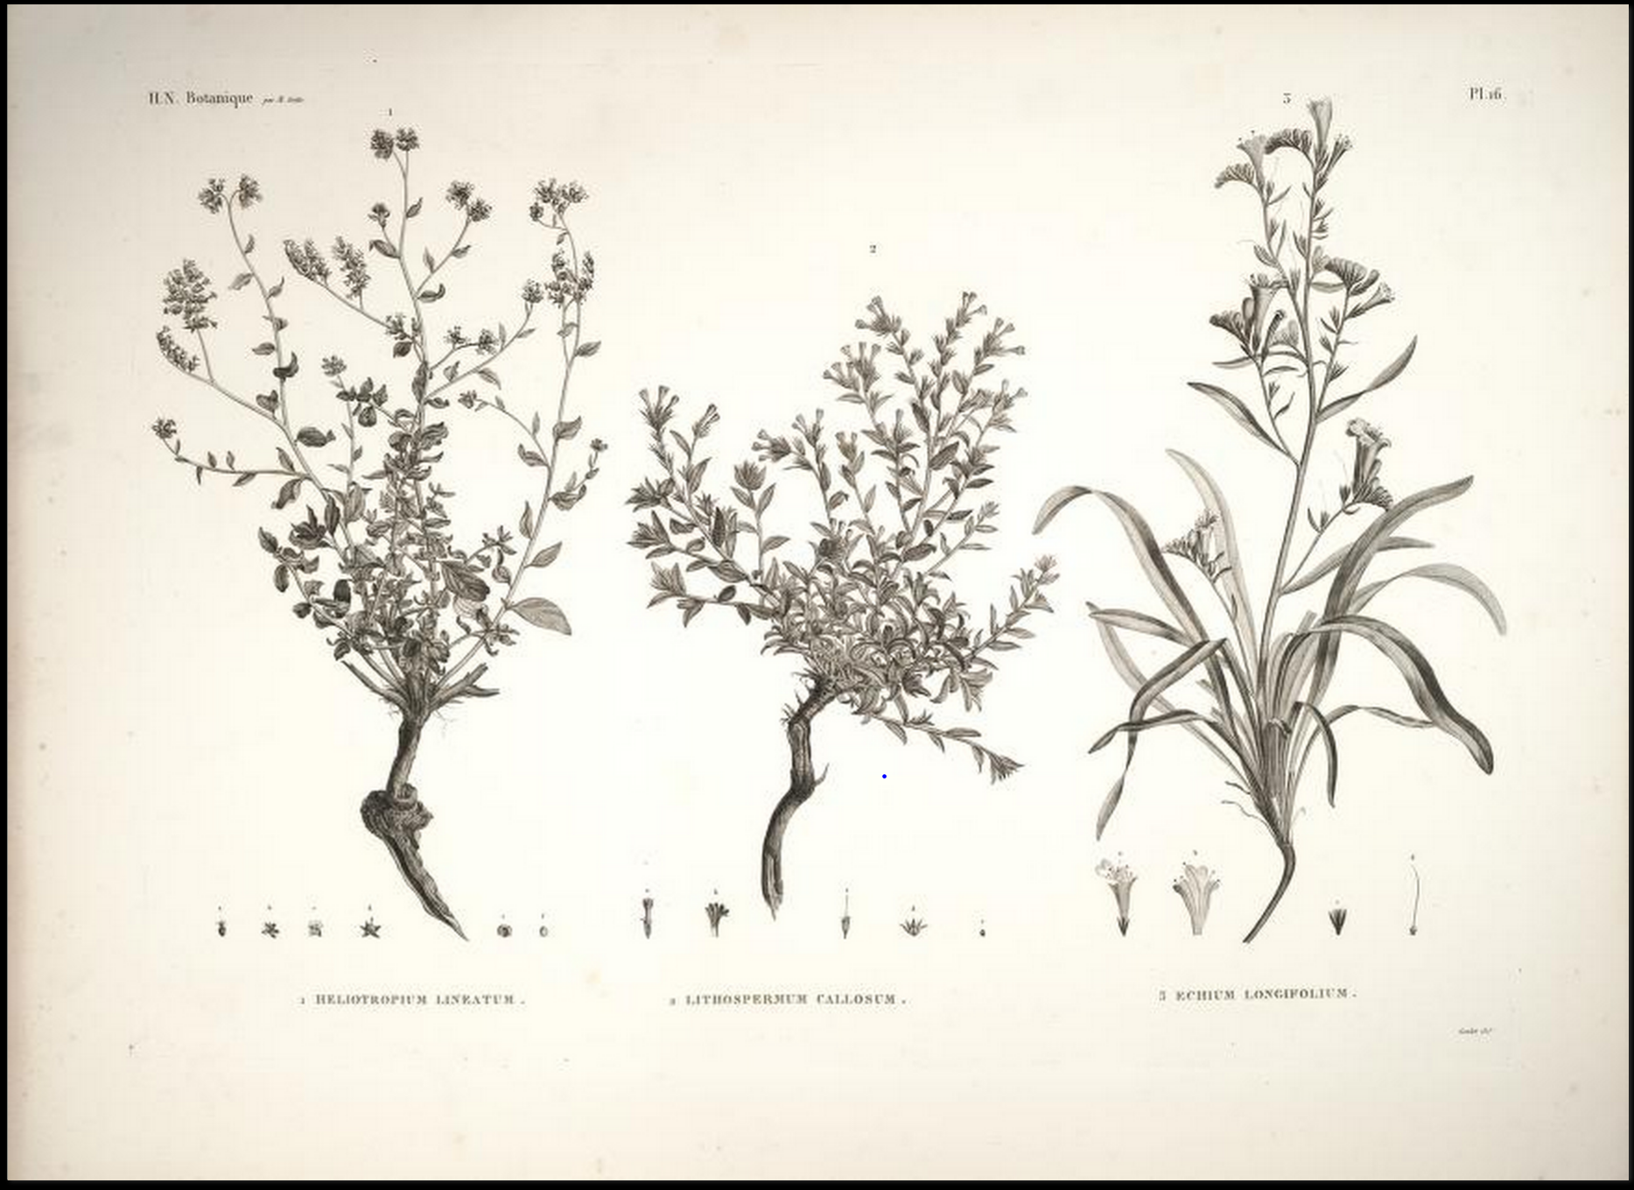
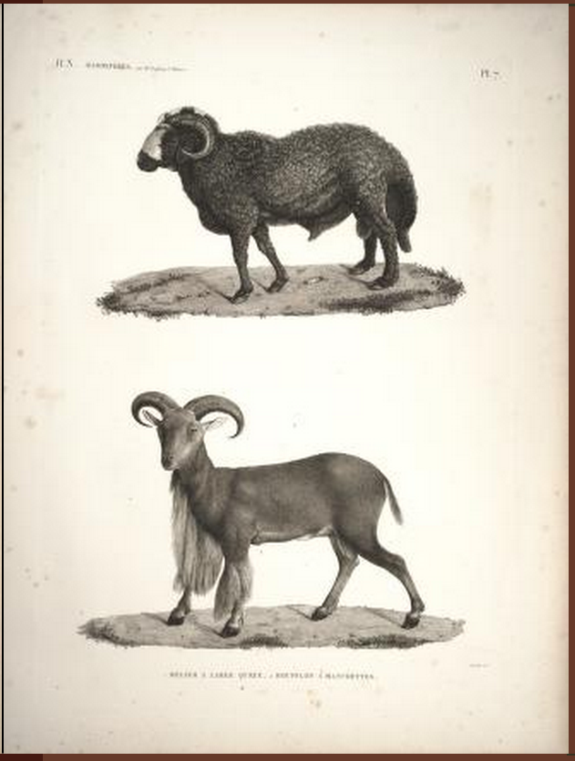
*See the SPARQL query
in this slide’s note.
Searched from the main page: http://bnb.data.bl.uk/
Source: British National Bibliography.
Title: Description of Egypt: http://bnb.data.bl.uk/id/resource/007491557
Notes:
Image credit: http://biodiversitylibrary.org/item/54152#page/1/mode/1up
Unlike the traditional catalog, or digital collections’ interfaces, linked data are not limited to one metadata standard. RDF makes it possible to integrate/mash up different metadata standards on the same data descriptions/webpages by defining the sources of metadata at the top of each webpage or sitemap, as long as the metadata can be represented as URIs in RDF triples.
SPARQL Query for this object:
PREFIX isbd: <http://iflastandards.info/ns/isbd/elements/>
PREFIX rdfs: <http://www.w3.org/2000/01/rdf-schema#>
CONSTRUCT {
# constructing properties of http://bnb.data.bl.uk/id/resource/007491557
<http://bnb.data.bl.uk/id/resource/007491557> isbd:P1073 ?var_1_0 .
<http://bnb.data.bl.uk/id/resource/007491557> ?var_2_0_prop ?var_2_0 .
?var_2_0 rdfs:label ?var_2_1_0 .
} WHERE {
# identifying properties of http://bnb.data.bl.uk/id/resource/007491557
{
<http://bnb.data.bl.uk/id/resource/007491557> isbd:P1073 ?var_1_0 .
} UNION {
<http://bnb.data.bl.uk/id/resource/007491557> ?var_2_0_prop ?var_2_0 .
OPTIONAL { ?var_2_0 rdfs:label ?var_2_1_0 . }
}
}

Slide 22
Description of Egypt. A partial RDF Turtle codes showing multiple metadata sources in the prefixes highlighted (in purple) below:
@prefix rdf: <http://www.w3.org/1999/02/22-rdf-syntax-ns#> .
@prefix elements: <http://iflastandards.info/ns/isbd/elements/> .
@prefix dct: <http://purl.org/dc/terms/> .
@prefix rdfs: <http://www.w3.org/2000/01/rdf-schema#> .
@prefix blterms: <http://www.bl.uk/schemas/bibliographic/blterms#> .
@prefix bibo: <http://purl.org/ontology/bibo/> .
@prefix owl: <http://www.w3.org/2002/07/owl#> .
@prefix foaf: <http://xmlns.com/foaf/0.1/> .
@prefix linked-data: <http://purl.org/linked-data/api/vocab#> .
@prefix void: <http://rdfs.org/ns/void#> .
Notes:
For example, the metadata above include:
Resource Description Framework (rdf): http://www.w3.org/1999/02/22-rdf-syntax-ns#
ISBD (elements): http://iflastandards.info/ns/isbd/elements/
Dublin Core metadata terms (dct): http://purl.org/dc/terms/
Resource Description Framework Schema (rdfs): http://www.w3.org/2000/01/rdf-schema#
blterms: http://www.bl.uk/schemas/bibliographic/blterms# and etc.
(British Library has its own metadata terms used here.)

Slide 23
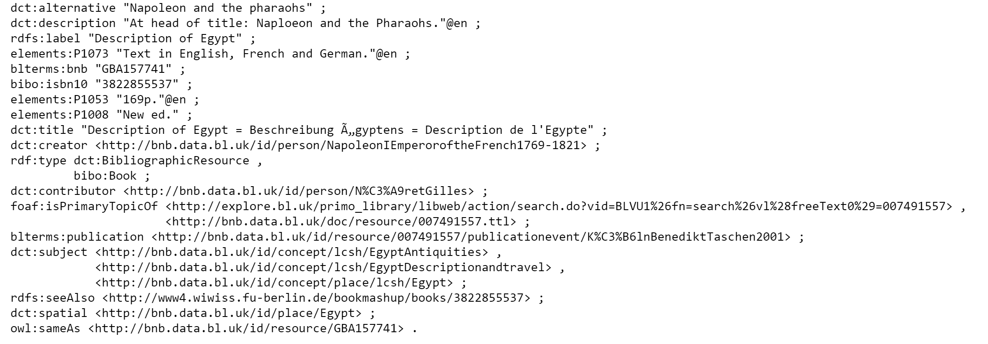
<http://bnb.data.bl.uk/id/resource/007491557> elements:P1042 "Previous ed: 1994."@en ;
Literal
BL’s own triple stores’ data:
http://bnb.data.bl.uk/doc/concept/lcsh/EgyptAntiquities
Notes:
(The same data continue.)
You can see here the metadata elements and their literals, or textual data values, in the quotation marks, while some other data elements are represented in the form of URIs.
This kind of data representation will be common as we move into BF and other kinds of linked data applications in the libraries, archives and museums communities.
Some data will need the manual input as in the literals or textual data values in the quotation marks.
Some data are readily available as web-based data we can bring in from their web-based sources, e.g. the authority data from id.loc.gov
BL also created its own authority data, for an example: http://bnb.data.bl.uk/doc/concept/lcsh/EgyptAntiquities

Slide 24
Linked data in OCLC’s Wolrdcat.org
http://www.worldcat.org/oclc/19607968

Slide 25
‘Les misérables’ as Linked data.

Slide 26
Data visualization & other New possibilities for libraries with linked data.

Slide 27
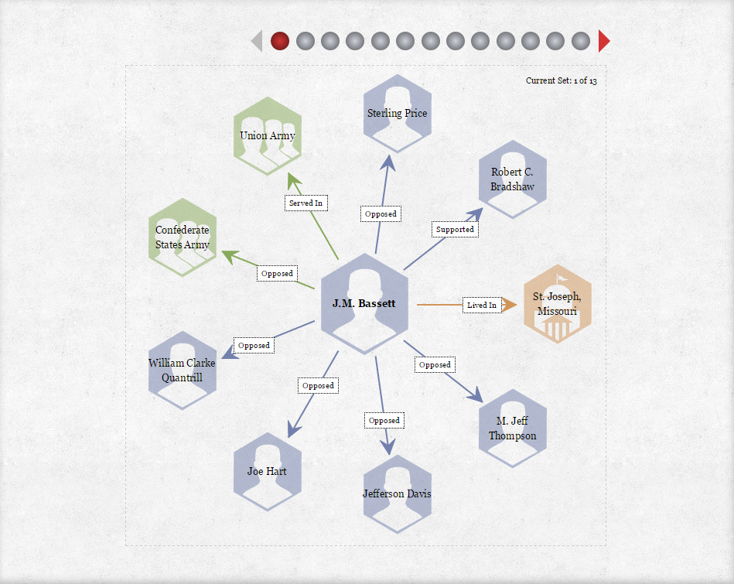
Notes:
From Kansas City Public Library’s Civil War on the Western Border: The Missouri-Kansas Conflict,1855-1865 Digital Project.
Linked Data/BF Project: http://www.civilwaronthewesternborder.org/
Relationship viewer:
http://www.civilwaronthewesternborder.org/content/relationship-viewer

Slide 28
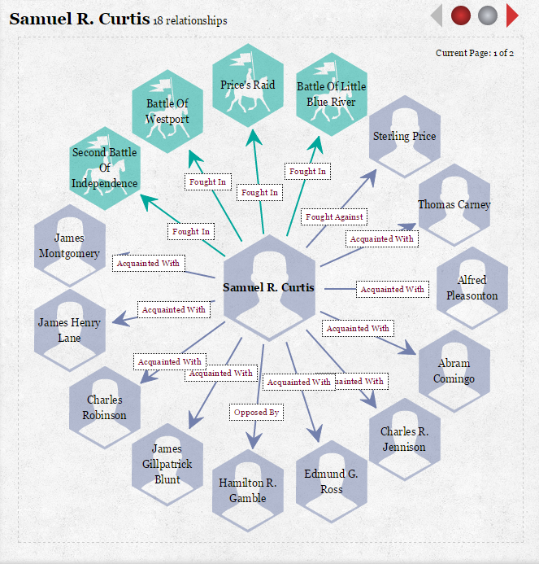
http://civilwaronthewesternborder.org/content/sara-robinson-my-dear-martha
Notes:
Kansas City Public Library’s Civil War on the Western Border: The Missouri-Kansas Conflict,1855-1865 Digital Project.
From Kansas City Public Library’s Civil War on the Western Border: The Missouri-Kansas Conflict,1855-1865 Digital Project.
Linked Data/BF Project: http://www.civilwaronthewesternborder.org/
Relationship viewer:
http://www.civilwaronthewesternborder.org/content/relationship-viewer
Wikipedia: Samuel Ryan Curtis was an American military officer, and one of the first Republicans elected to Congress. He was most famous for his role as a Union Army general in the Trans-Mississippi Theater of the American Civil War.
The relationship viewer allows you to see the connections among people, groups, places and events.
The viewer also shows his connection with other Union Army members and acquaintances, plus his opponents and the battles he fought in.

Slide 29
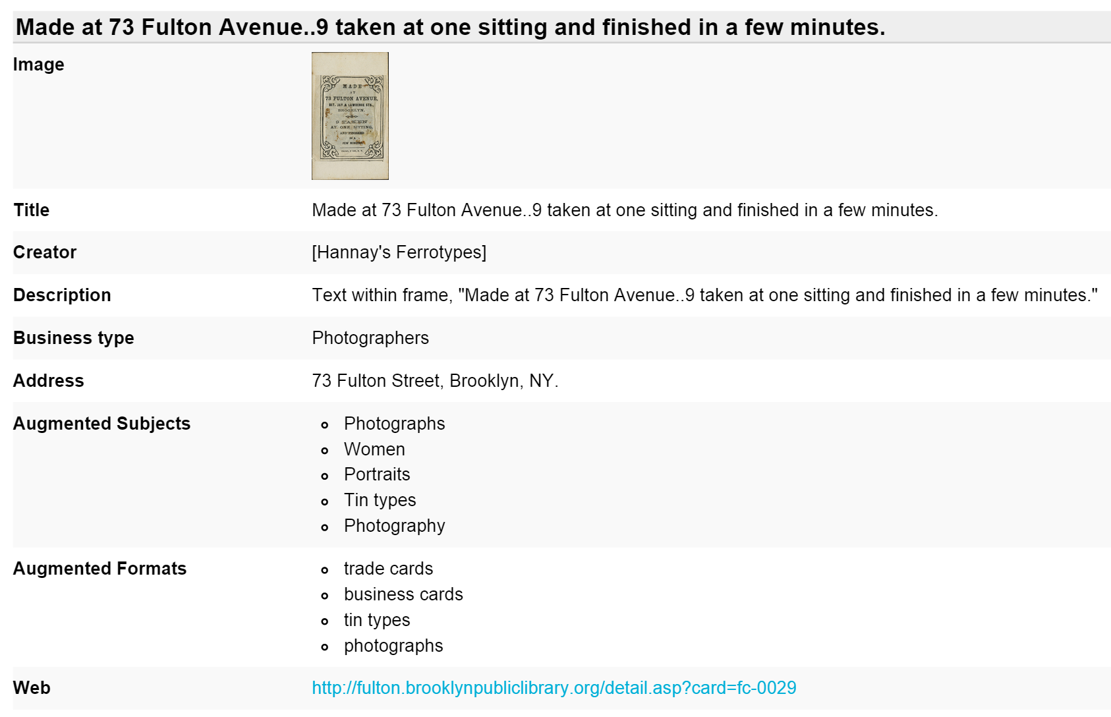
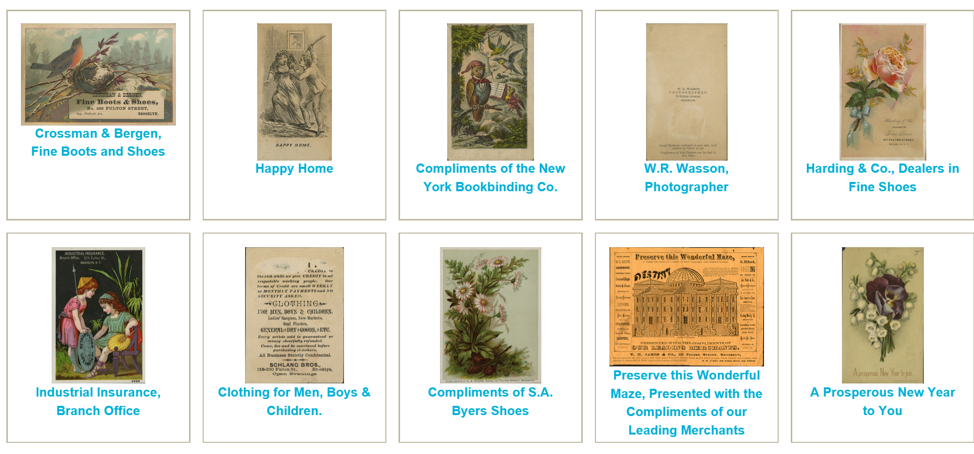
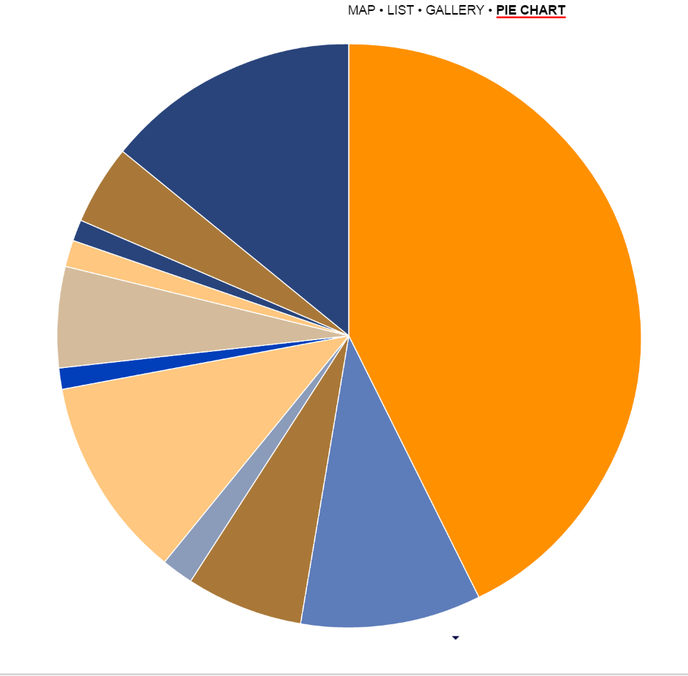
Viewshare: Fulton Street Trade Cards collection
Notes:
Viewshare: Data visualization tool developed by the Library of Congress and Zepheira.
http://viewshare.org/views/jefferson/fulton-street-trade-cards-collection/
The Fulton Street Trade Cards collection features 245 late 19th and early 20th century illustrated trade cards from merchants along the Fulton Street retail stores thoroughfare in Brooklyn, NY.
You can see the maps of the retail stores based on the address metadata, the list of the cards, the images with metadata and the pie charts representing types of the stores by proportion.

Slide 30
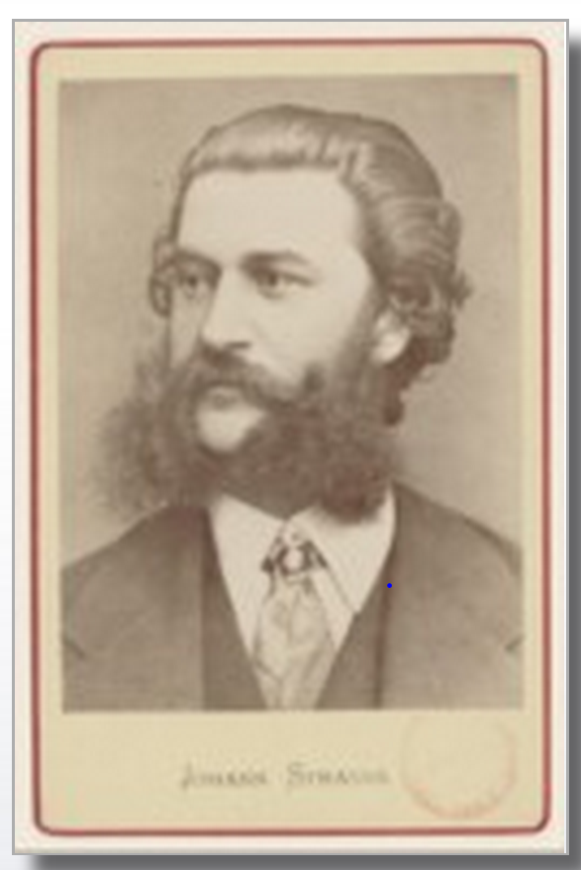
Notes:
http://data.bnf.fr/13900121/johann_strauss/
French National Library: leveraging the power of library data on the Web.
A linked data project at Bibliothèque Nationale de France (BnF - French National Library) to make the data produced by the BnF more visible on the Web, and to
federate the data produced by the BnF, both within and outside the catalogues.
With the linked data, you can combine the (name) authority data with the rest of your collections’ data as you can see in this case. It combined Strauss’s name authority data with the list of his works by musical genres, other documents about him (mostly from the BnF catalog) and other sources. The results are presented as a linked-data webpage.

Slide 31
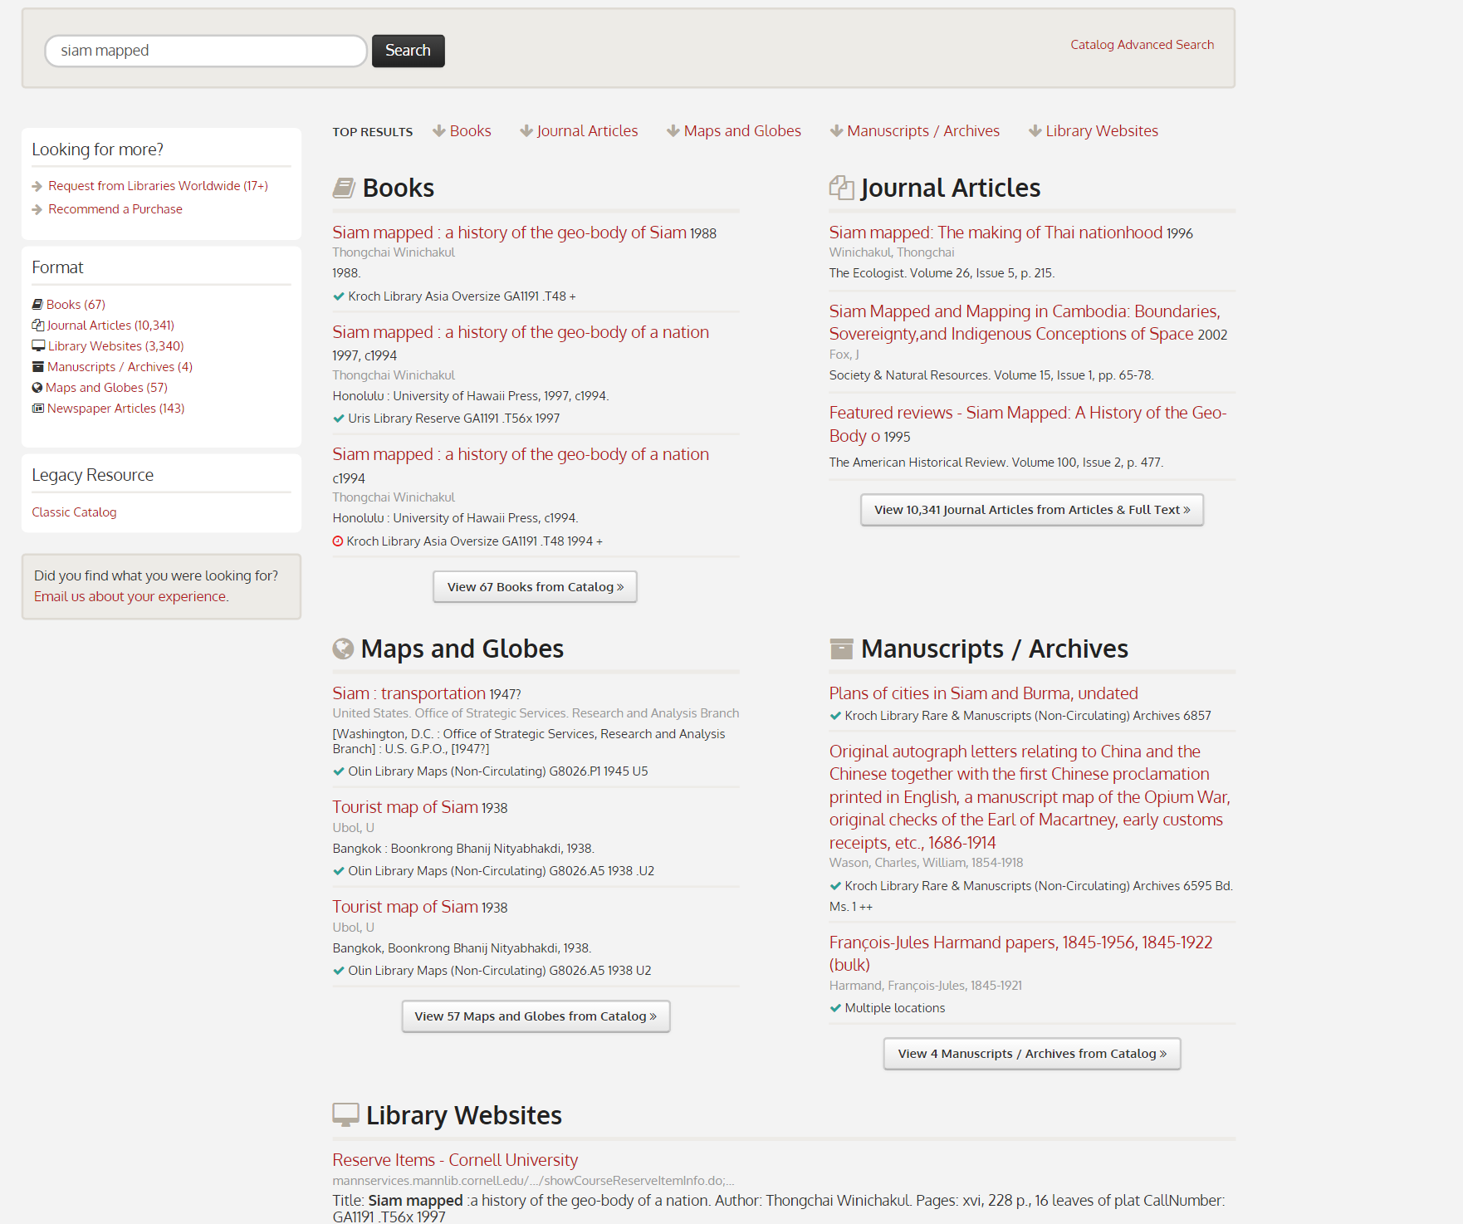
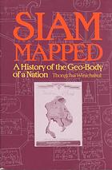
Cornell University Library ‘Siam mapped’
LD4L
https://search.library.cornell.edu/?q=siam+mapped
Notes:
Linked Data for Libraries (LD4L) project. The project is a collaboration of the Cornell University Library, the Harvard Library Innovation Lab, and the Stanford University Libraries, and was funded by a nearly $1 million two-year grant from the Andrew W. Mellon Foundation.
“The overall objective of these efforts is to transcend traditional library information silos (books in a catalog, articles in a database or abstract and indexing services, people in a directory), and enable seamless discovery of all relevant works (books, articles, and more) on any defined topics, by any authors.)”
https://wiki.duraspace.org/display/ld4l/Previous+Partner+LD+Work
So in this example, the search gave you the results drawn from different collections within the libraries based on the linked data connections via Blacklight (an open- source web application).
Book: Thongchai Winichakul. 1994. Siam mapped a history of the geo-body of a nation. Honolulu: University of Hawaii Press.
http://www.worldcat.org/oclc/44954726

Slide 32
Discovery services
Notes:
Challenges.
Currently, there are multiple choices of discovery services and the service platforms offered are becoming more similar. For example, EDS started off as EBSCO databases, then it leveraged its search power into a full-service discovery tool. In the future it will include circulation and patron information, thus becoming a full Library Service Platform with an API to directly search the data in the local system without libraries having to upload their data to be indexed. It is the technology that will be made possible because of the cloud-based platforms. OCLC WorldShare also started from a single cataloging platform which now grew into a full library service platform and more.
Issues: technical, budget, workflow/workloads, staffing and etc.
On the other hand, when libraries put their information in the cloud and on the Web, it also allows the interaction with open-source software, such as Blacklight and Invenio and other IR platforms (e.g., Digital Commons and Dspace) and also the data repositories, such as VIVO or ORCID, for example.
Open Access and Open Data, Open Content are also on the rise as predicted by NMC Horizon Report, but it already exists for quite some time in many scientific and social science data repositories.

Slide 33
Discovery Services
Opportunities & Challenges:
Multiple Choices of Discovery Services
WorldShare, Summon, EDS, ENCORE, Primo, etc.
Open Source Software (Blacklight, Invenio, Kaltura, etc.)
Open Content (OER, DPLA, Europeana, Wikidata, Geonames, Arabic Collection Online, and etc.)
BIBFRAME & Schema.org
= New players
Zepheira, Kuali-OLE, BIBFLOW, LC’s contracts with Smart Software Inc. & Index Data.com,
and so forth.
Notes:
So the challenges are to look at both the proprietary system and open source software and licensed and open access content. We will be using these parallel sets of resources for some time.
The role of metadata services on this issue is to participate in the decision-making process to choose the resources and systems by understanding both the technical implication as well as issues related to budget and human resources, workflows, etc. that will go with them.

Slide 34
The road map to bibframe
NEXT STEPS?
Notes:
Image credit: Luke Detwiler’s photostream on Flickr, Gordon Creek Road: http://goo.gl/9v5CHo
Well, where do we go from here?

Slide 35
How to plan for the Transition to BIBFRAME & Linked Data: recommendations.

Slide 36
Recommendation: Cataloging & Metadata Services’ Action Plan
Education and training on BIBFRAME and linked data (workshops, conferences, etc., plus in-house training)
Explore the option to be an early adopter/tester (with LC) of BIBFRAME.
Clean your data to get ready for the data transformation.
Pilot your own project or experiment with BIBFRAME.
Monitor the development of BIBFRAME, Schema.org, linked data and other web and GLAM technologies.
Notes:
Image credit: Neurons in the zebrafish’s brain: https://commonfund.nih.gov/highlights_2010
Linked data is natural and we can find it in ourselves and in the nature.
BIBFLOW is a project at University of California–Davis Library with Zepheira to plan for BIBFRAME’s implementation for the entire library organization by analyzing workflows across the units: http://www.lib.ucdavis.edu/bibflow/about/.

Slide 37
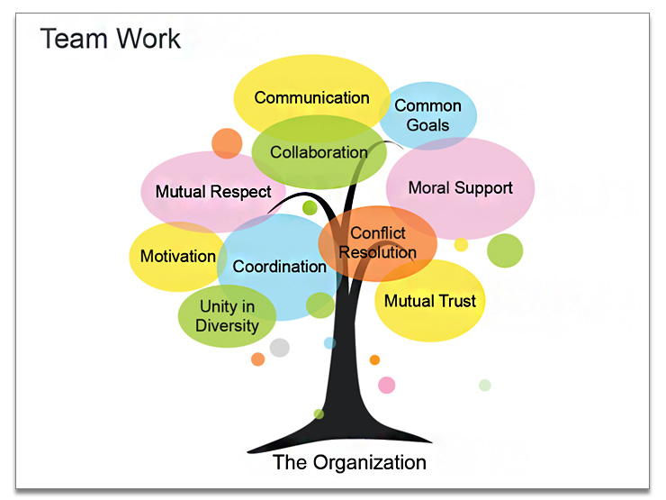
Recommendation: A Library-Wide action plan.
Education and transition planning for BIBFRAME and linked data in your library via a steering committee charged with:
Facilitating discussions and planning sessions
Keeping your library community informed on the new development.
Assessing the impact on your library.
Designing the in-house training program for your library.
An assessment of your library’s readiness for BIBFRAME based on the BIBFLOW Project.
Plan for BIBFRAME’s implementation based on the assessment data.
Notes:
Image credit: Team work: https://www.muezart.com/keynote-text-tree-infographics-sample

Slide 38
Notes:
But of course, we need to make sure you know how to swim! That’s what the training is for!

Slide 39
You can now join: AMICAL Linked Data & BIBFRAME Interest Group
http://connect.amicalnet.org/group/linked-data-bibframe-interest-group

Slide 40
Additional RESOURCES (1)
Semantic Web Basics: http://www.linkeddatatools.com/semantic-web-basics
RDFa Primer: http://www.w3.org/TR/rdfa-primer/
SPARQL Query: http://www.w3.org/TR/sparql11-overview/
Schema.org & Biblioraph.net
Linked Open Data Cloud: http://datahub.io/group/lodcloud
OCLC’s Data Strategy and Linked Data: http://www.oclc.org/data.en.html
LC Linked Data Services: http://id.loc.gov/
Getty Vocabularies as LOD: http://www.getty.edu/research/tools/vocabularies/lod/index.html
BIBFRAME: http://bibframe.org/
Tools: editors and transformer: http://bibframe.org/tools/
Testing and implementation: http://hangingtogether.org/?p=4487
BIBFRAME Update at ALAMW15: https://www.youtube.com/watch?v=Aqjcc70K7x0
Zepheira, LLC: http://zepheira.com/solutions/library/
Semantic Web in Libraries: http://swib.org/

Slide 41
Additional Resources (2)
Godby, Carol Jean, and Ray Denenberg. 2015. Common ground: exploring compatibilities between the linked data models of the Library of Congress and OCLC. http://www.oclc.org/research/publications/2015/oclcresearch-loc-linked-data-2015.html
LDL4 – Use cases: https://wiki.duraspace.org/display/ld4l/LD4L+Use+Cases
Miller, Eric and Uche Obbuji. 2015. “Linked Data Design for the Visible Library.” Bulletin of the American Society for Information Science and Technology 41, no. 4: 23-29. http://www.asis.org/Bulletin/Apr-15/AprMay15_Miller_Ogbuji.pdf
NMC Horizon Report: 2015 Higher Education Edition. 2015. Austin Texas: New Media Consortium. http://cdn.nmc.org/media/2015-nmc-horizon-report-HE-EN.pdf
Schreur, Philip Evan. 2012. "The Academy Unbound." Library Resources & Technical Services 56, no. 4: 227-237. https://stacks.stanford.edu/file/druid:bd701dh8028/Academy%20Unbound.pdf
Tillett, Barbara B. 2003. What is FRBR?: a conceptual model for the bibliographic universe. [Washington, D.C.]: Library of Congress, Cataloging Distribution Service. http://www.loc.gov/cds/downloads/FRBR.PDF .

Slide 42
Image Credits
Slide no. 3:
Berners-Lee, Tim. 1998. Semantic Web’ Road Map: http://www.w3.org/DesignIssues/Semantic.html
Berners-Lee, T., J. Hendler, and O. Lassila. 2001. "The Semantic Web". SCIENTIFIC AMERICAN -AMERICAN EDITION-. 284: 28-37.
Slide no. 4:
Miller, Eric. (2015). Accelerating the Visible Library. In: The Visible Library: Learn how the Web sees libraries. A Library Journal webcast presented by Atlas Systems, Zepheira and Library Journal, Thursday, February 26, 2015, slide no. 60: https://goo.gl/mZRBIK
Linking Open Data cloud diagram 2014, by Max Schmachtenberg, Christian Bizer, Anja Jentzsch and Richard Cyganiak. http://lod-cloud.net/
Slide no. 18:
Description de l'Égypte: http://dx.doi.org/10.5962/bhl.title.62506
data.bnf.fr Project by Bibliothèque Nationale de France:
http://data.bnf.fr/13900121/johann_strauss/
Slide 29:
Change by Us. Created by Libby Levi and Meredith Atwater for opensource.com: http://goo.gl/ZF0uOR
Slide 30:
Luke Detwiler’s photo stream on Flickr, Gordon Creek Road: http://goo.gl/9v5CHo
Slide 32:
Neurons in the zebra fish's brain: https://commonfund.nih.gov/highlights_2010
Slide 33:
Team work: https://www.muezart.com/keynote-text-tree-infographics-sample

Slide 43
Thank you!

